Slide 1

python · main.py — open
1/4 Abid START
SPEAKER Md. Muntasir Abid · opens the presentation
> Adventure Quest
A Dynamic Narrative Game Using Factor Graphs
CSE440 · Artificial Intelligence · Group Project · Summer 2026 · Group 9
Md. Muntasir Abid
Md. Abdullah Al Maruf
Sabbir Ahmed
Sayed Rimon Ahamed

Slide 2
python · team.md
1/4 Abid
SPEAKER Md. Muntasir Abid · introducing the team
> Group Introduction
Md. Muntasir Abid
Project Plan · Story Design · README · Documentation
Md. Abdullah Al Maruf
Game World · Locations · Player State System
Sabbir Ahmed
Factor Graph AI · Decision Logic (factor_graph.py)
Sayed Rimon Ahamed
Game Loop · Events · GUI (Tkinter) · Integration

Slide 3
python · goal.md
1/4 Abid
SPEAKER Md. Muntasir Abid · problem + goal
> Problem Statement & Goal
The Problem
Our Goal
Most simple adventure games follow a fixed storyline
Every player experiences the same sequence of events
This makes gameplay predictable and repetitive
Build an adventure game whose story reacts to player state
Apply Factor Graphs to drive AI-based event selection
Track Health, Gold, Weapon, Reputation & Location
Give different players genuinely different playthroughs
Demonstrate a real AI technique in an approachable way
Md. Muntasir Abid · Md. Abdullah Al Maruf · Sabbir Ahmed · Sayed Rimon Ahamed

Slide 4
python · architecture
1/4 Abid END
SPEAKER Md. Muntasir Abid · structure + repo layout
> Approach — Modular Python + Tkinter GUI
cse440-project/
├── src/
│ ├── main.py # launches the Tkinter GUI
│ ├── gui.py # AdventureGUI — screens & rendering
│ ├── game.py # Game — routes events by location
│ ├── factor_graph.py # AdventureFactorGraph — AI core
│ ├── events.py # per-event outcome functions
│ └── player.py # Player state (health, gold, ...)
├── assets/images/ # location & character art
├── diagrams/ # factor graph diagram
└── docs/ # plan · story · factor graph design
How it flows
main.py starts the Tkinter GUI
GUI drives Game, which asks: what happens next?
Game checks player.location and routes the event
Forest events are chosen by the Factor Graph AI
Next: each member covers their part in order

Slide 5
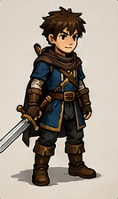
python · docs/Story.md
2/4 Maruf START
SPEAKER Md. Abdullah Al Maruf · story + world
> The Story — Search for the Ancient Crystal
The kingdom's greatest treasure, the Ancient Crystal, lies hidden in a mysterious cave
The player is an adventurer setting out to find it
Along the way: explore locations, meet characters, collect items, face challenges
Every decision affects future events — no two playthroughs are identical
Goal: find the Crystal and complete the adventure safely
The Adventurer
Md. Muntasir Abid · Md. Abdullah Al Maruf · Sabbir Ahmed · Sayed Rimon Ahamed

Slide 6
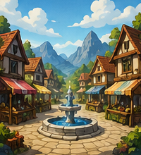
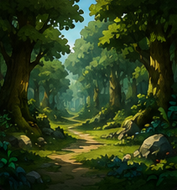

python · docs/Story.md — locations
2/4 Maruf
SPEAKER Md. Abdullah Al Maruf · three game locations
> Game World — Three Locations
Village
Forest
Cave
Merchant · Old Man · Rest at Inn
Wolf Attack · Hidden Treasure · Lost Traveler
Goblin Battle · Ancient Crystal · Final Guardian

Slide 7
python · src/player.py
2/4 Maruf END
SPEAKER Md. Abdullah Al Maruf · player state · variables
> Player State System
class Player:
def __init__(self):
self.health = 100
self.gold = 30
self.weapon = False
self.reputation = "Good"
self.location = "Village"
self.crystal = False
def is_alive(self):
return self.health > 0
Five variables drive everything
Health — High / Low
Gold — High / Low
Weapon — Yes / No
Reputation — Good / Bad
Location — Village / Forest / Cave

Slide 8
python · docs/factor_graph.md
3/4 Sabbir START
SPEAKER Sabbir Ahmed · factor graph concept
> What Is a Factor Graph?
A Factor Graph connects variables through "factor" nodes that score how well combinations of values fit together
Instead of checking one condition at a time, it weighs several player variables together before deciding the outcome
In this game, the factor graph replaces a fixed sequence of events with a state-aware decision process
Different player states → different factor scores → different events, even from the same location

Slide 9
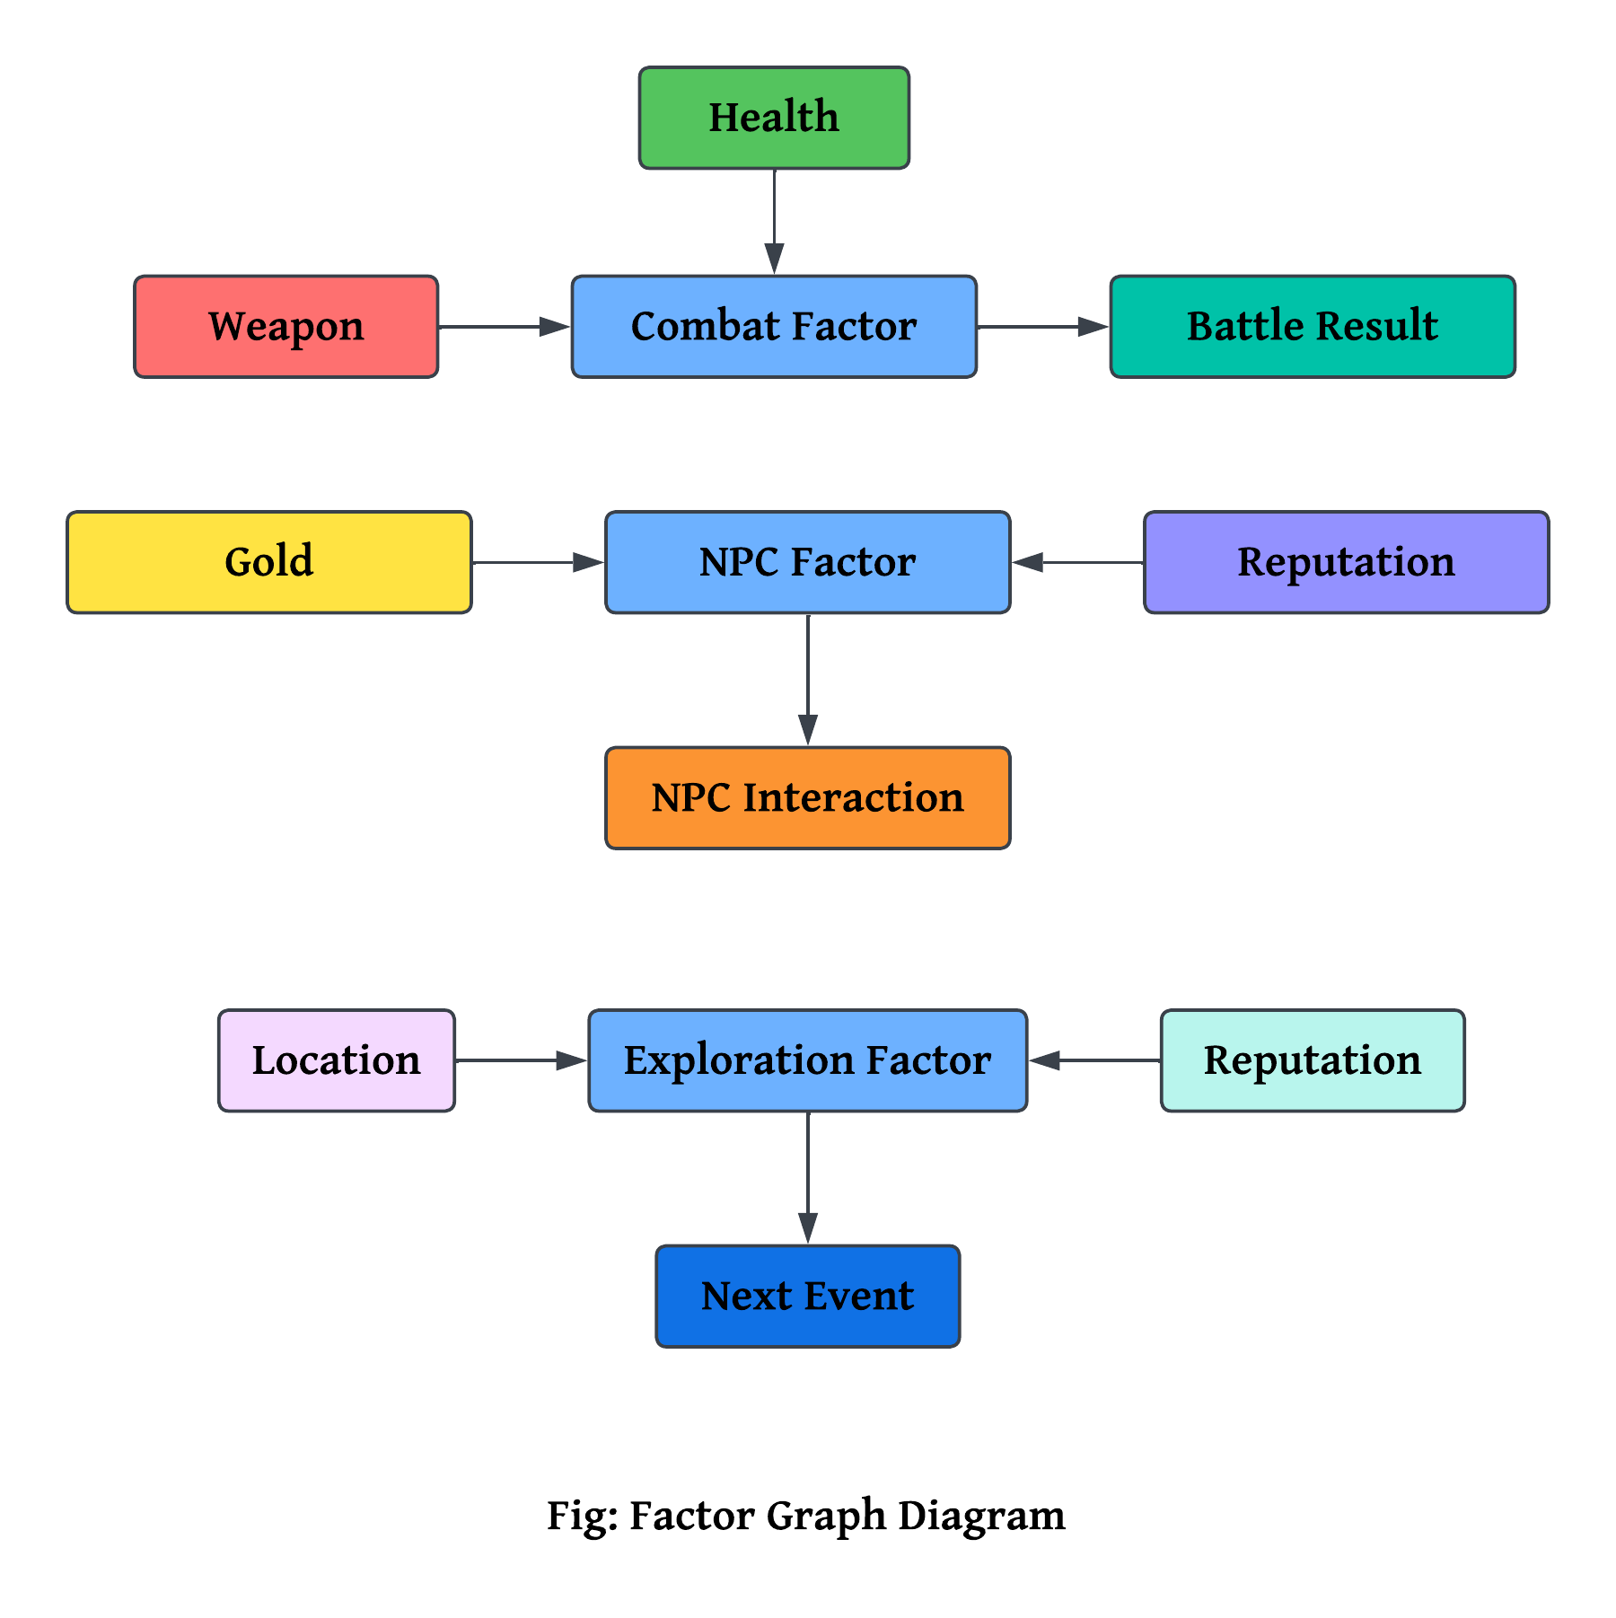
python · diagrams/factor_graph.png
3/4 Sabbir
SPEAKER Sabbir Ahmed · our factor graph design
> Our Factor Graph Design
Three factor nodes
Combat — Health + Weapon → battle result
NPC Interaction — Gold + Reputation → how NPCs respond
Exploration — Location + Reputation → next event

Slide 10
python · src/factor_graph.py
3/4 Sabbir
SPEAKER Sabbir Ahmed · combat factor · pgmpy
> Combat Factor — Built with pgmpy
# Health, Weapon -> Event
combat = DiscreteFactor(
["Health", "Weapon", "Event"],
[2, 2, 3],
np.array([
0.2, 0.6, 0.2, # low health, no weapon
0.1, 0.2, 0.7, # low health, weapon
0.7, 0.2, 0.1, # high health, no weapon
0.3, 0.5, 0.2, # high health, weapon
]).reshape(2, 2, 3)
)
Reading it
Each row is a probability distribution over event types
A player with high health & a weapon leans toward a fair fight
Low health, no weapon → the graph favors safer outcomes
pgmpy's DiscreteFactor stores and evaluates these tables

Slide 11
python · src/factor_graph.py
3/4 Sabbir END
SPEAKER Sabbir Ahmed · NPC & exploration factors
> NPC Interaction & Exploration Factors
# Reputation, Gold -> Event
social = DiscreteFactor(
["Reputation", "Gold", "Event"],
[2, 2, 3], np.array([...]))
# Location, Reputation -> Event
exploration = DiscreteFactor(
["Location", "Reputation", "Event"],
[3, 2, 3], np.ones(18))
What each one does
Social — good reputation & spare gold win over NPCs (help, discounts)
Bad reputation → NPCs may be cold or refuse to help
Exploration — location & reputation shape which world event fires
All three factors feed into one shared "Event" variable

Slide 12
python · choose_event()
4/4 Rimon START
SPEAKER Sayed Rimon Ahamed · decision process in the game loop
> From Player State to the Next Event
1
Read the player's current state (health, gold, weapon, reputation)
2
Send the variables into the Factor Graph
3
Score each event type: combat, social, exploration
4
Normalize the scores into probabilities
5
Randomly select an event weighted by those probabilities
6
Run the event function and update the player's state

Slide 13
python · src/gui.py
4/4 Rimon
SPEAKER Sayed Rimon Ahamed · GUI + technology stack
> Interface & Technology Stack
Tkinter GUI
Core Libraries
Replaces a console loop with a graphical adventure screen
Shows location art, event text, and player status
Buttons drive choices instead of typed commands
gui.py wires the GUI directly to Game and Player
Python — game logic and application structure
Tkinter — graphical user interface
pgmpy — Factor Graph model & DiscreteFactor tables
NetworkX & Matplotlib — factor graph diagram generation
Git & GitHub — version control across the semester

Slide 14
python · end_game()
4/4 Rimon
SPEAKER Sayed Rimon Ahamed · endings + current progress
> Possible Endings & Current Progress
Three Endings
Where We Are
Good — the Crystal is found, adventure completed safely
Neutral — the Crystal is found, but health or resources are low
Bad — the player's health reaches zero before the goal
Done: story, locations, player system, Factor Graph AI, game loop, GUI
Working: main.py → GUI → Game → Factor Graph → Events, end to end
In progress: final documentation and polish
Next: extended testing across more player-state combinations

Slide 15
python · github — wrap up
4/4 Rimon END
SPEAKER Sayed Rimon Ahamed · closes · GitHub wrap + thank you
> GitHub Wrap-Up & Thank You
Quick scroll through commit history — semester-long teamwork
Confirm folders: src/ · assets/ · diagrams/ · docs/
docs/ holds the project plan, story design & factor graph design
Team: Abid (plan/story) · Maruf (world) · Sabbir (AI) · Rimon (game/GUI)
Thank you — we're ready for questions

